Slide 1
Comp 4350 Software Engineering II Lecture 4
Dr. Shaowei Wang

Slide 2






The rapid release cycle of modern software systems
Often release several times
in one day!
2￼

Slide 3








Release pipelines:
How organizations deliver new content
+
+
-
-
1. Integration
Modern software organizations
rely on an
efficient and robust
release pipeline!
2. Build
3. Deployment
New!
3￼
Notes:
May take over one hour to build a project from scratch

Slide 4
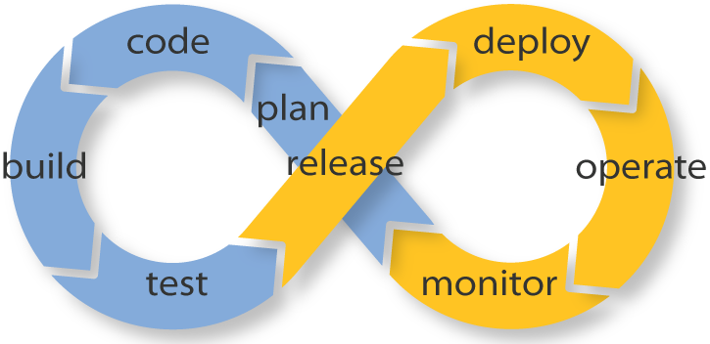
DevOps
DevOps is the practice of operations and development engineers participating together in the entire service lifecycle, from design through the development process to production support, to increase organization’s ability to deliver products faster, while ensure high quality

Slide 5
Continuous integration
Continuous integration is a DevOps software development practice where developers frequently merge their code changes into a central repository, after which automated builds and tests are run on the branch.
Notes:
Why we say auto build is the first phase DevlOps kniks in. Here we come out with a concept called CI

Slide 6






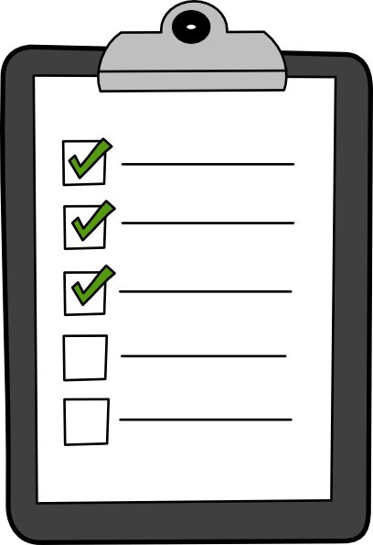

Continuous Integration (CI)
Commit
Commit 9719cf0
.java
.xml
Build
Commit 9719cf0 was successfully integrated
Report
Test
6￼

Slide 7
Continuous integration benefits
Improve developer productivity
Find and address bugs quickly
Deliver updates faster
Notes:
The rationale is that it’s easier to identify defects and other software quality issues on smaller code differentials than on larger ones developed over an extensive period.

Slide 8
Continuous Integration (CI)
Commit
Commit 9719cf0
.java
.xml
Build
Commit 9719cf0 was successfully integrated
Report
Test
8￼

Slide 9





Studying the Software Development Overhead
of Build Systems
What is a build system?
Source code
Deliverable
9￼
Modern software organizations rely on an efficient and robust build system!

Slide 10












Why we need a build system?
Build systems describe how sources are
translated into deliverables automatically.
.java
.class
.jar
.java
.class
.zip
.tex
.dvi
.pdf
10￼

Slide 11






gcc -c random.c
gcc -c input.c
gcc -c main.c
Compile random.c input.c main.c
Link them together to complete the program

Slide 12

gcc -c random.c
gcc random.o \
input.o \
main.o \
-o program
gcc -c input.c
gcc -c main.c
Link them together to complete the program
Notes:
Object is the compiled code, mostly machine code

Slide 13

gcc -c random.c
gcc random.o \
input.o \
main.o \
-o program
gcc -c input.c
gcc -c main.c
D’oh! We need to fix a bug in random.c!

Slide 14

gcc -c random.c
gcc random.o \
input.o \
main.o \
-o program
gcc -c input.c
gcc -c main.c
Recompile random.c

Slide 15
gcc -c random.c
gcc random.o \
input.o \
main.o \
-o program
gcc -c input.c
gcc -c main.c
Relink the objects together
Notes:
imagine we have 1000's of files

Slide 16
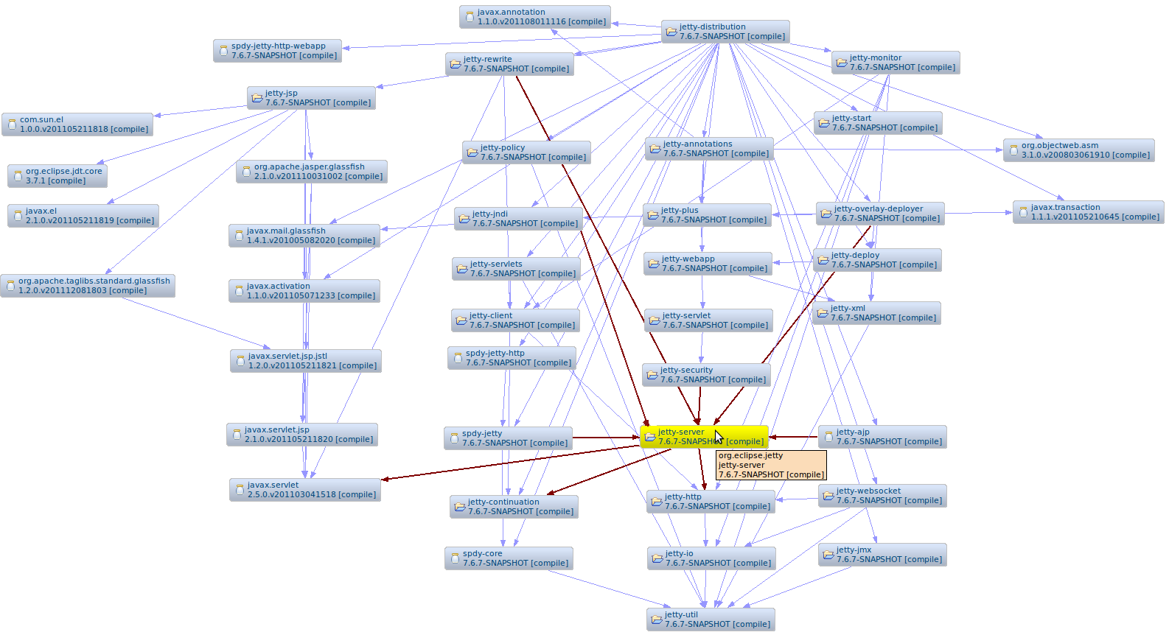
It’s extreme hard to build large system manually
Jetty dependency tree

Slide 17
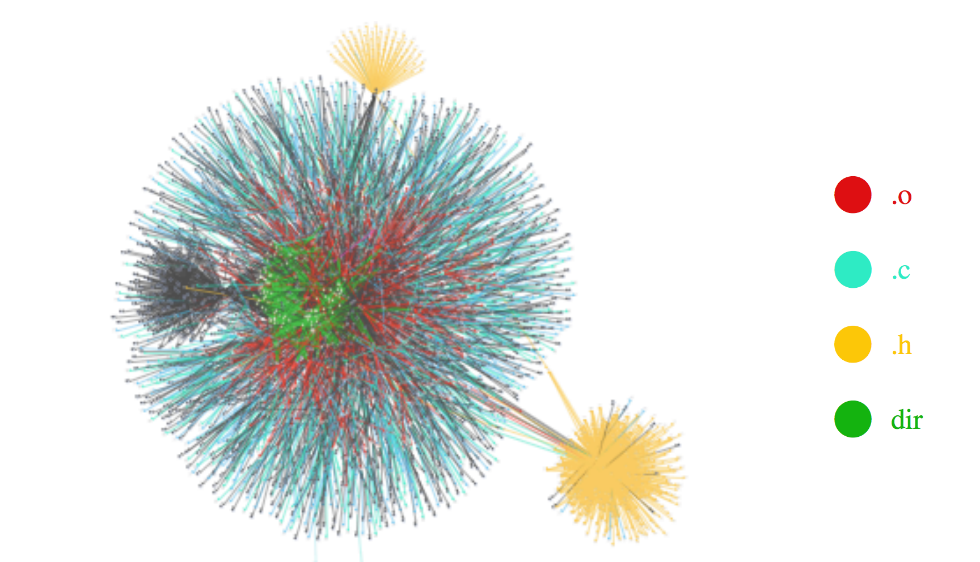
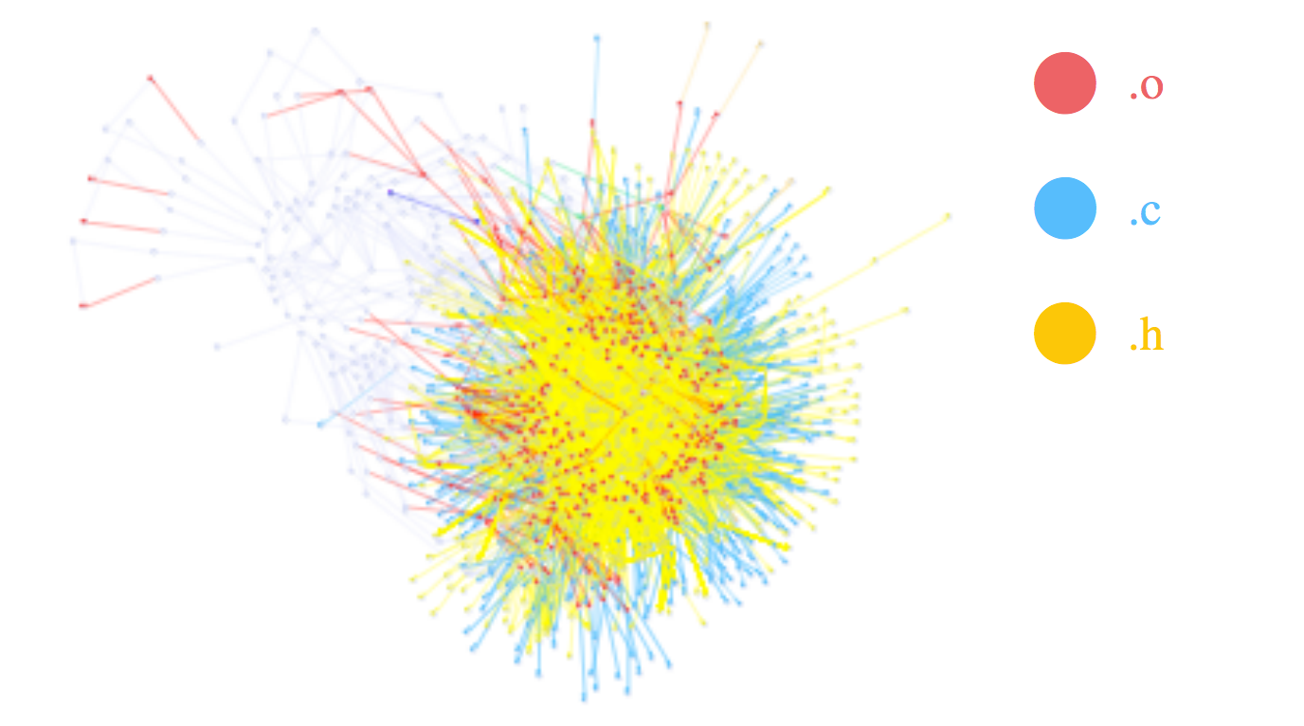
Build dependency graph
Linux 2.6
Linux 2.4

Slide 18

How can I re/build the system?
Build systems make these decisions for you!

Slide 19
Build tools
Ant
A Java library used for automating build processes for Java applications as a replacement for the Make build tool of Unix. The main benefit of Ant is its flexibility.
XML format
Maven
A build automation tool used primarily for Java projects. Maven can be considered a plugin execution framework, since all work is done by plugins.
XML format
Gradle
A build automation tool that was built upon the concepts of Ant and Maven.
Written in Groovy or Kotlin
PyBuilder
A build automation tool
Written in python
Notes:
Another developer then reviews the changes they’ve made, and once they’re happy there are no issues, they approve the pull-request. This manual review is supposed to be quick and lightweight, but it’s effective at identifying issues early.

Slide 20
How does build system work?
Define the dependency
Define the action

Slide 21
make to the rescue
gcc main.o \
-o program
Step 2 -
Writing
recipes
Step 1 - Expressing dependencies
Notes:
Any line in the makefile that begins with a tab and appears in a “rule context” (that is, after a rule has been started until another rule or variable definition) will be considered part of a recipe for that rule.

Slide 22


This is a
Makefile
Step 1 - Expressing dependencies
program : random.o input.o main.o
Target
- An output file

Slide 23


Step 1 - Expressing dependencies
program : random.o input.o main.o
Target
- An output file

Slide 24


Step 1 - Expressing dependencies
program : random.o input.o main.o
Dependencies
Targets that must be built prior to building this one

Slide 25
Step 2 -
Writing recipes
program : random.o input.o main.o
<tab>gcc -o program random.o input.o main.o
Notes:
missing dependency -> error
changes in dependency -> re-compile
recipe: one or more command lines that need to be executed

Slide 26
Step 2 -
Writing recipes
program : random.o input.o main.o
<tab>gcc -o program random.o input.o main.o
random.o : random.c
<tab>gcc -c random.c
input.o : input.c
<tab>gcc -c input.c
main.o : main.c
<tab>gcc -c main.c
Notes:
This is our Makefile
-c Compile or assemble the source files, but do not link
: shows dependency

Slide 27
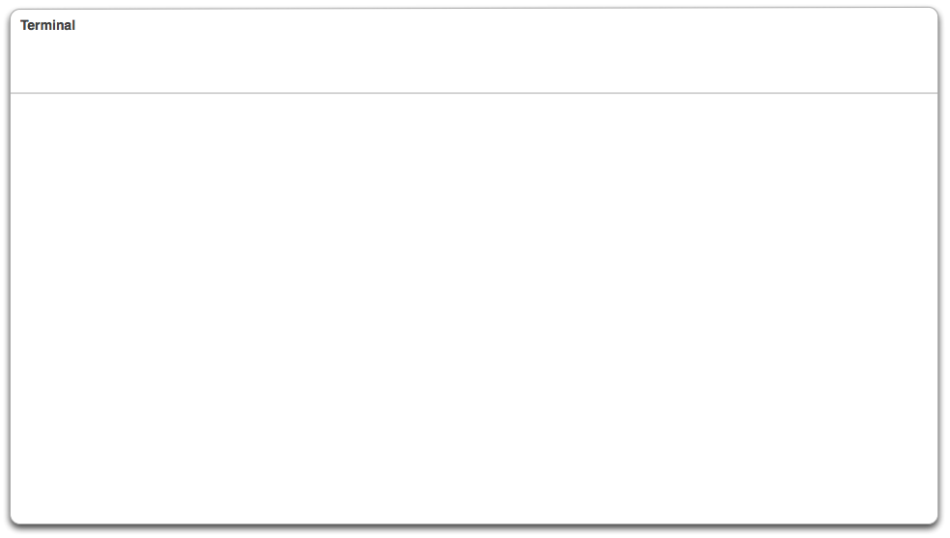
make command reads the makefile
$ make
gcc -c random.c
gcc -c input.c
gcc -c main.c
gcc -o program random.o input.o main.o
$
Notes:
Execute the first target in the Makefile

Slide 28
gcc -c random.c
gcc random.o \
input.o \
main.o \
-o program
gcc -c input.c
gcc -c main.c
Should we rebuild entire system?
Notes:
imagine we have 1000's of files

Slide 29
Continuous integration
Continuous integration is a DevOps software development practice where developers frequently merge their code changes into a central repository, after which automated builds and tests are run on the branch.
Notes:
Why we say auto build is the first phase DevlOps kniks in. Here we come out with a concept called CI

Slide 30

make Incremental Builds!
$ vim random.c
...
$ make
gcc -c random.c
gcc -o program random.o input.o main.o
$
Only the out-of-date targets are rebuilt!

Slide 31
How does incremental build work?

Slide 32
First of all – build the dependency graph
program : random.o input.o main.o
<tab>gcc -o program random.o input.o main.o
random.o : random.c
<tab>gcc -c random.c
input.o : input.c
<tab>gcc -c input.c
main.o : main.c
<tab>gcc -c main.c

Slide 33
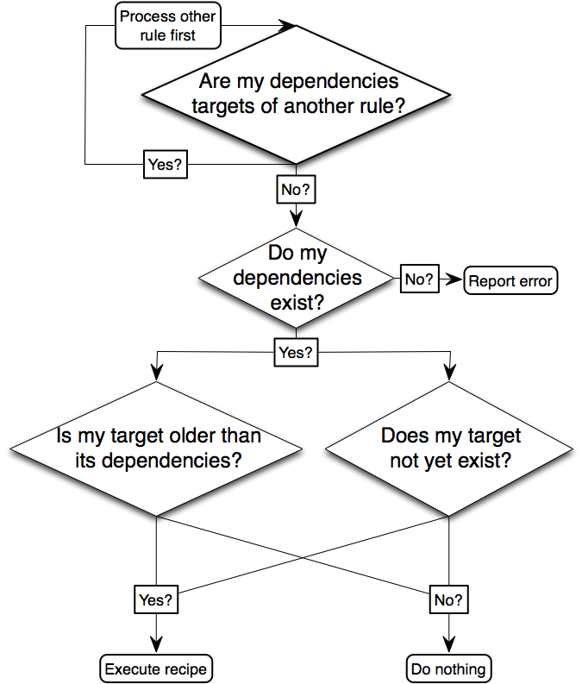
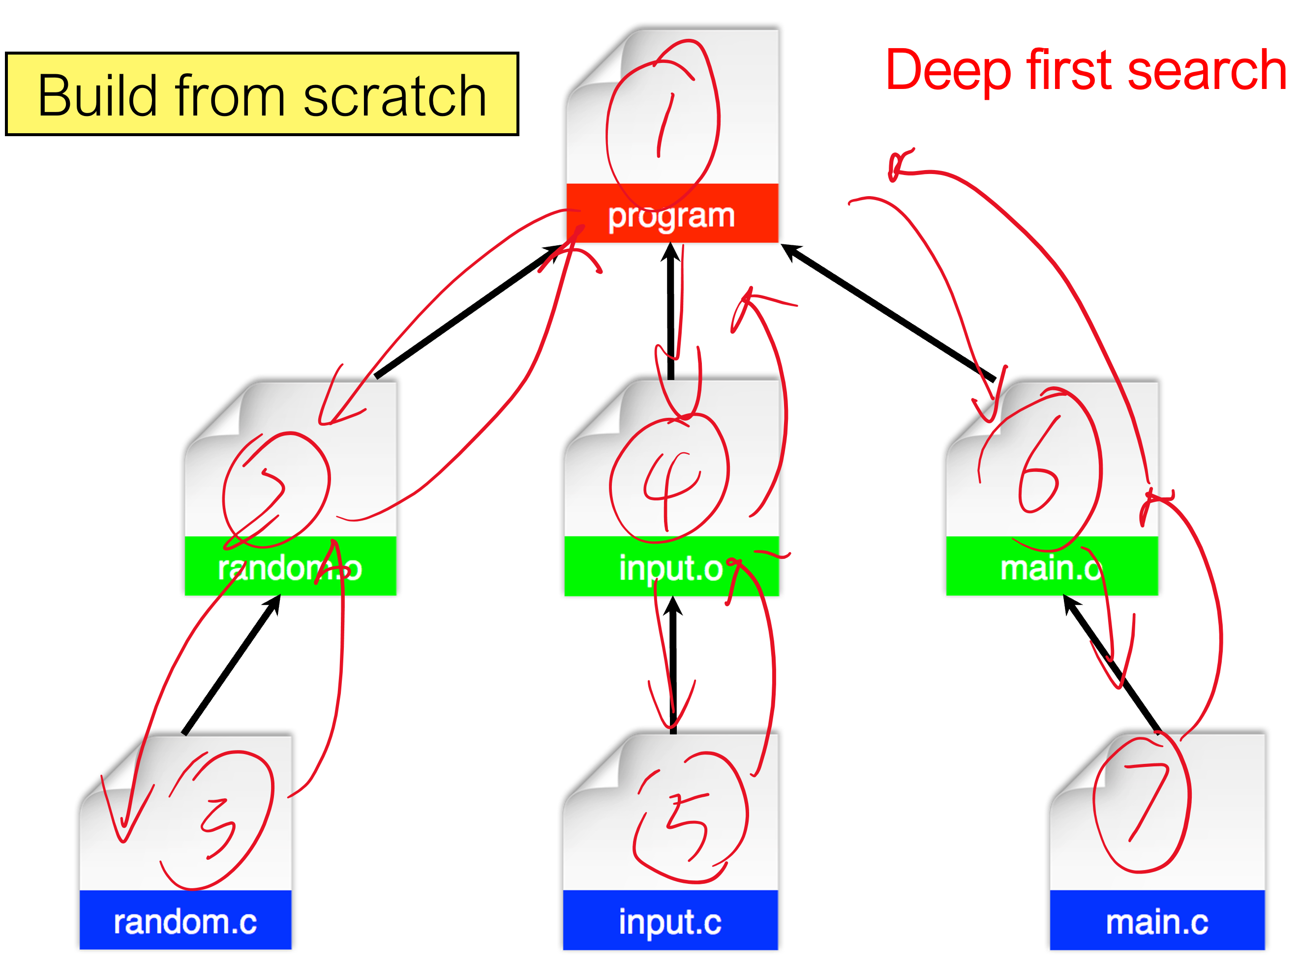
program : random.o input.o main.o
<tab>gcc -o program random.o input.o main.o
random.o : random.c
<tab>gcc -c random.c
input.o : input.c
<tab>gcc -c input.c
main.o : main.c
<tab>gcc -c main.c

Slide 34
Only random.c is modified
promgramis older than random.o =>receipt is executed
Random.o is older than random.c =>receipt is executed
Input.o is newer than input.c => nothing happens
main.o is newer than main.c => nothing happens
Notes:
Random.o is older than random.c, so the receipt is executed. When coming to input.0 and main.o, they are not. So return without execuction.

Slide 35
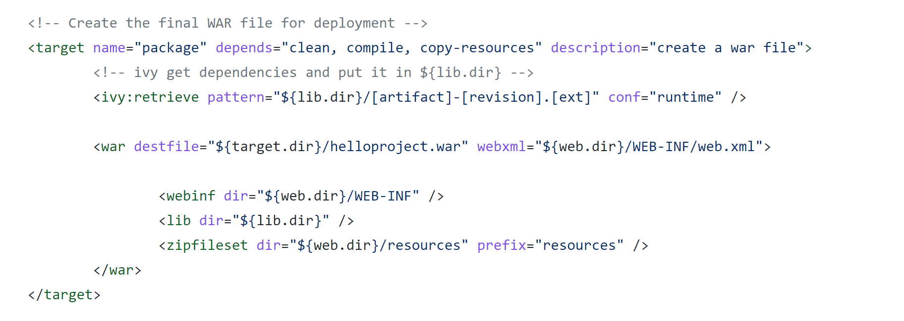
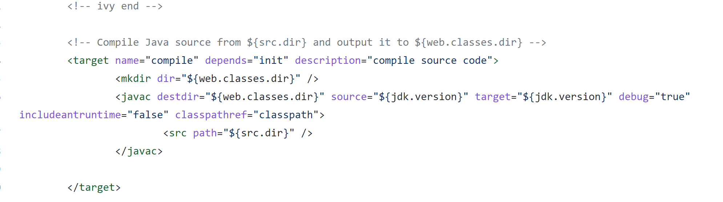
Ant build file
https://github.com/shaoweiwang2010/SE_course_JunitTest_Demo/blob/master/build.xml

Slide 36
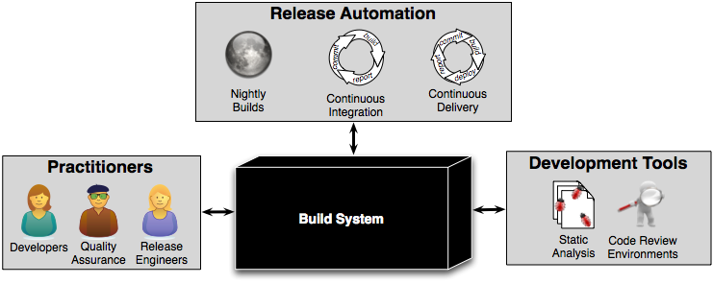
How clients do interact with build system?
Notes:
who do you think interact with the build system?
Different developers and tools interact (or can be integrated) with the build process and the release pipeline

Slide 37
Build systems have a
variety of clients

Slide 38
Build system interactions:
Quality Assurance Personnel
QA and Builds:
Builds should be configured to perform most tests automatically
QA teams hook automated tests into the build system
Since normal builds need to provide a fast feedback loop, only quick tests run in a typical builds
Slower tests can be relegated to special build targets that are executed less often

Slide 39
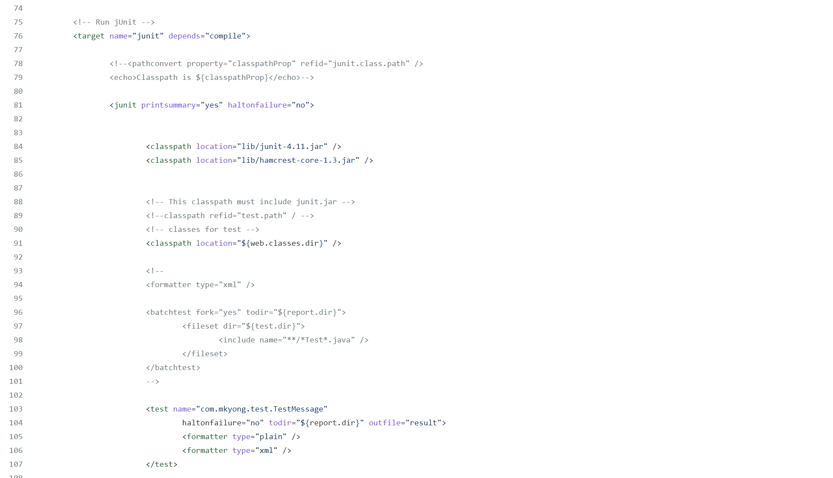

https://github.com/shaoweiwang2010/SE_course_JunitTest_Demo/blob/master/build.xml
Notes:
Junit follows up the compiling

Slide 40
Build systems have a
variety of clients

Slide 41
Build system interactions:
Static analysis
Static analysis and builds:
Static analysis can be triggered with the build command (e.g., Google’s ErrorProne)
Scan the source code or byte code for common bugs like resource leaks and dead code

Slide 42
Build system interactions:
Code review environments
Code review and builds:
Modern code review tools like Gerrit execute builds to provide early feedback for reviewers
Check out https://codereview.qt-project.org/#/c/140545/
Sanity bot’s feedback is from the build system

Slide 43
Build system interactions:
Nightly builds
Builds are sometimes on a schedule:
QA teams can pick up version that is going to be released to do thorough testing on the new features and validate the bug fixes during night
Notes:
Here, a build can be the release of a new version of the software

Slide 44
Build system interactions:
The problem with nightly builds
Night builds are too infrequent:
As the amount of change per day has grown, nightly builds have become difficult
Consider the case when a nightly build does not complete cleanly
If hundreds of developers have committed changes, it’s hard to tell who caused the problem!
Imagine you broke the build, but you wrote the code yesterday! Hard to recall!

Slide 45
Build system interactions:
The problem with nightly builds
Night builds are too infrequent:
As the amount of change per day has grown, nightly builds have become difficult
Consider the case when a nightly build does not complete cleanly
If hundreds of developers have committed changes, it’s hard to tell who caused the problem!
Imagine you broke the build, but you wrote the code yesterday! Hard to recall!
We need to run builds
more frequently to keep up
with fast-paced development!

Slide 46
Martin Fowler’s practice on CI
Maintain a Single Source Repository.
Make it Easy for Anyone to Get the Latest Executable
Everyone can see what's happening
Automate the Build
Keep the Build Fast
Fix Broken Builds Immediately
Everyone Commits To the Mainline Every Day
Every Commit Should Build the Mainline on an Integration Machine
Test in a Clone of the Production Environment
Make Your Build Self-Testing
Notes:
Single source repository -> any change will be reflect on the working repositories and everyone can see the change, several benefits 1) review purpose

Slide 47
Continuous integration tools
On-premises:
Jenkins
CruiseControl
Buildbot
Cloud-based:
GitHub Action
TravisCI
CloudBees
CircleCI

Slide 48
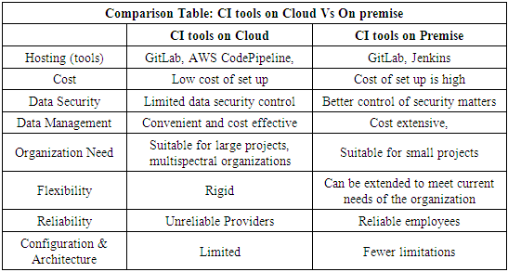
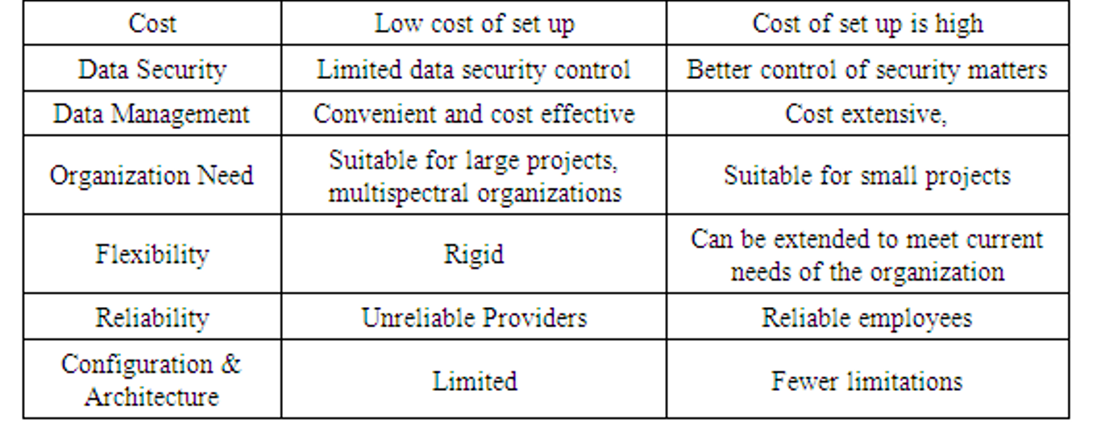
On-premises VS Could-based

Slide 49
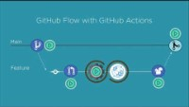
Github Actions

Slide 50
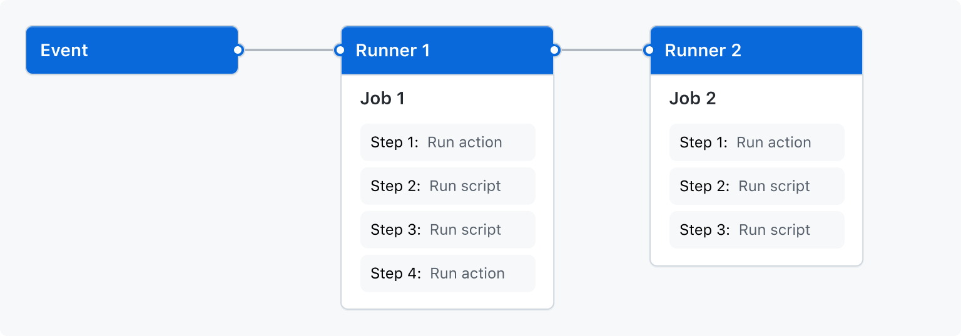
GitHub Actions workflow
GitHub Actions workflow to be triggered when an event occurs in your repository, (pull request being opened or an issue being created).
Your workflow contains one or more jobs which can run in sequential order or in parallel.
Each job will run inside its own virtual machine runner, or inside a container, and has one or more steps that either run a script that you define or run an action, which is a reusable extension that can simplify your workflow.

Slide 51
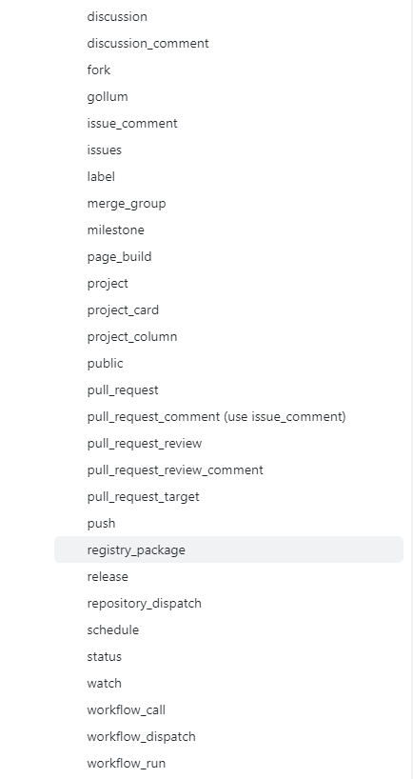
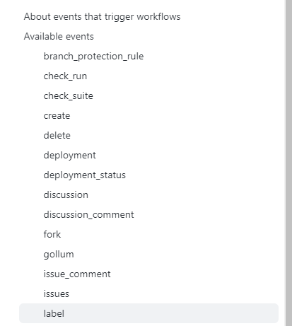
Event
https://docs.github.com/en/actions/using-workflows/events-that-trigger-workflows

Slide 52
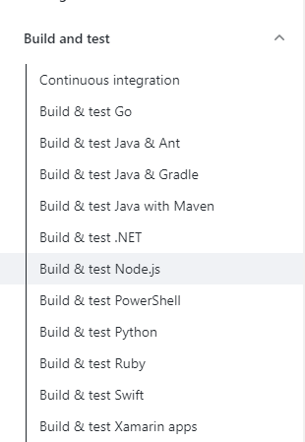
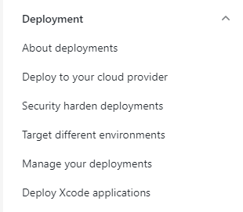
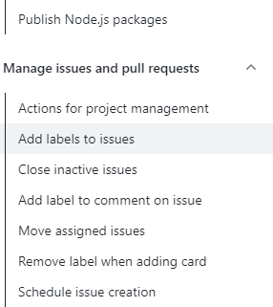
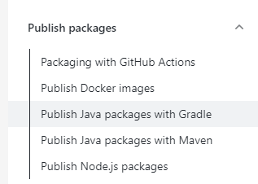
Action

Slide 53
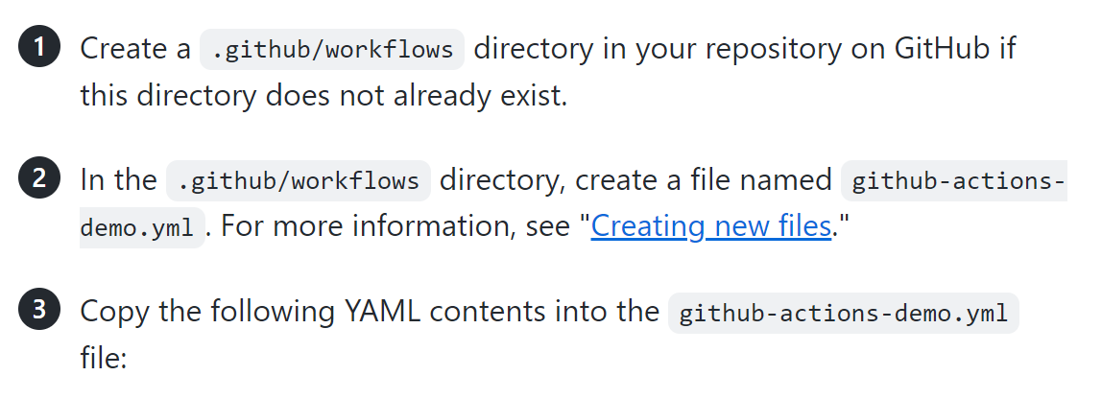
Set up GtiHub Action for a GitHub project
Tutorial (https://docs.github.com/en/actions/quickstart)
Github repo https://github.com/shaoweiwang2010/SEII_GithubAction_Demo

Slide 54
name: GitHub Actions Demo
on: [push]
jobs:
Explore-GitHub-Actions:
runs-on: ubuntu-latest
steps:
- run: echo "🎉 The job was automatically triggered by a ${{ github.event_name }} event."
- run: echo "🐧 This job is now running on a ${{ runner.os }} server hosted by GitHub!"
- run: echo "🔎 The name of your branch is ${{ github.ref }} and your repository is ${{ github.repository }}."
- name: Check out repository code
uses: actions/checkout@v2
- run: echo "💡 The ${{ github.repository }} repository has been cloned to the runner."
- run: echo "🖥️ The workflow is now ready to test your code on the runner."
- name: List files in the repository
run: |
ls ${{ github.workspace }}
- run: echo "🍏 This job's status is ${{ job.status }}."

Slide 55
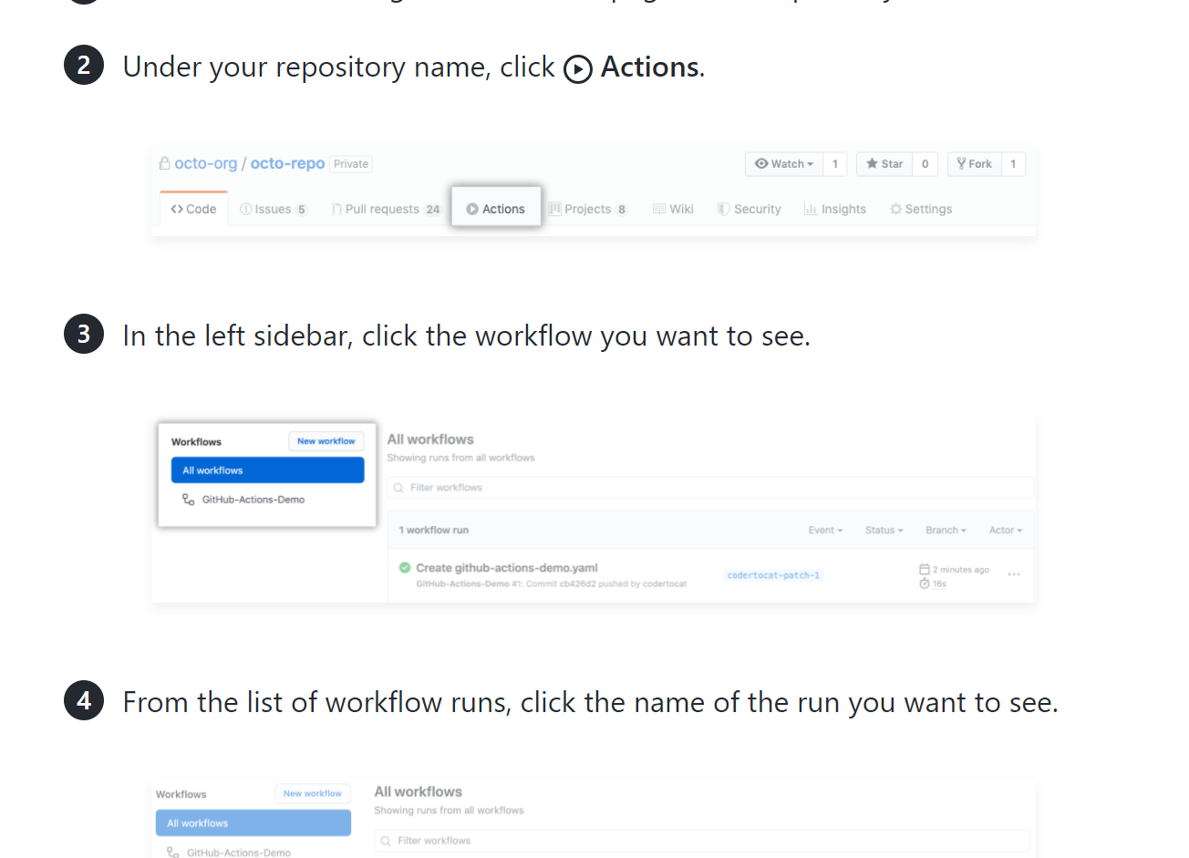
You need to show your CI works and have tests available in the Sprint 2!

Slide 56
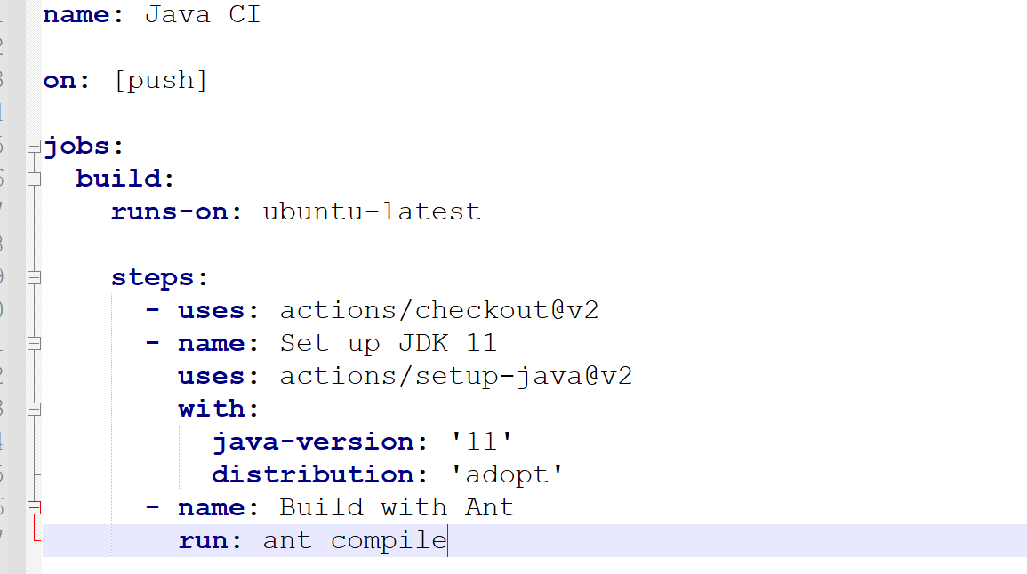
Build with Ant
https://docs.github.com/en/actions/automating-builds-and-tests/building-and-testing-java-with-ant

Slide 57
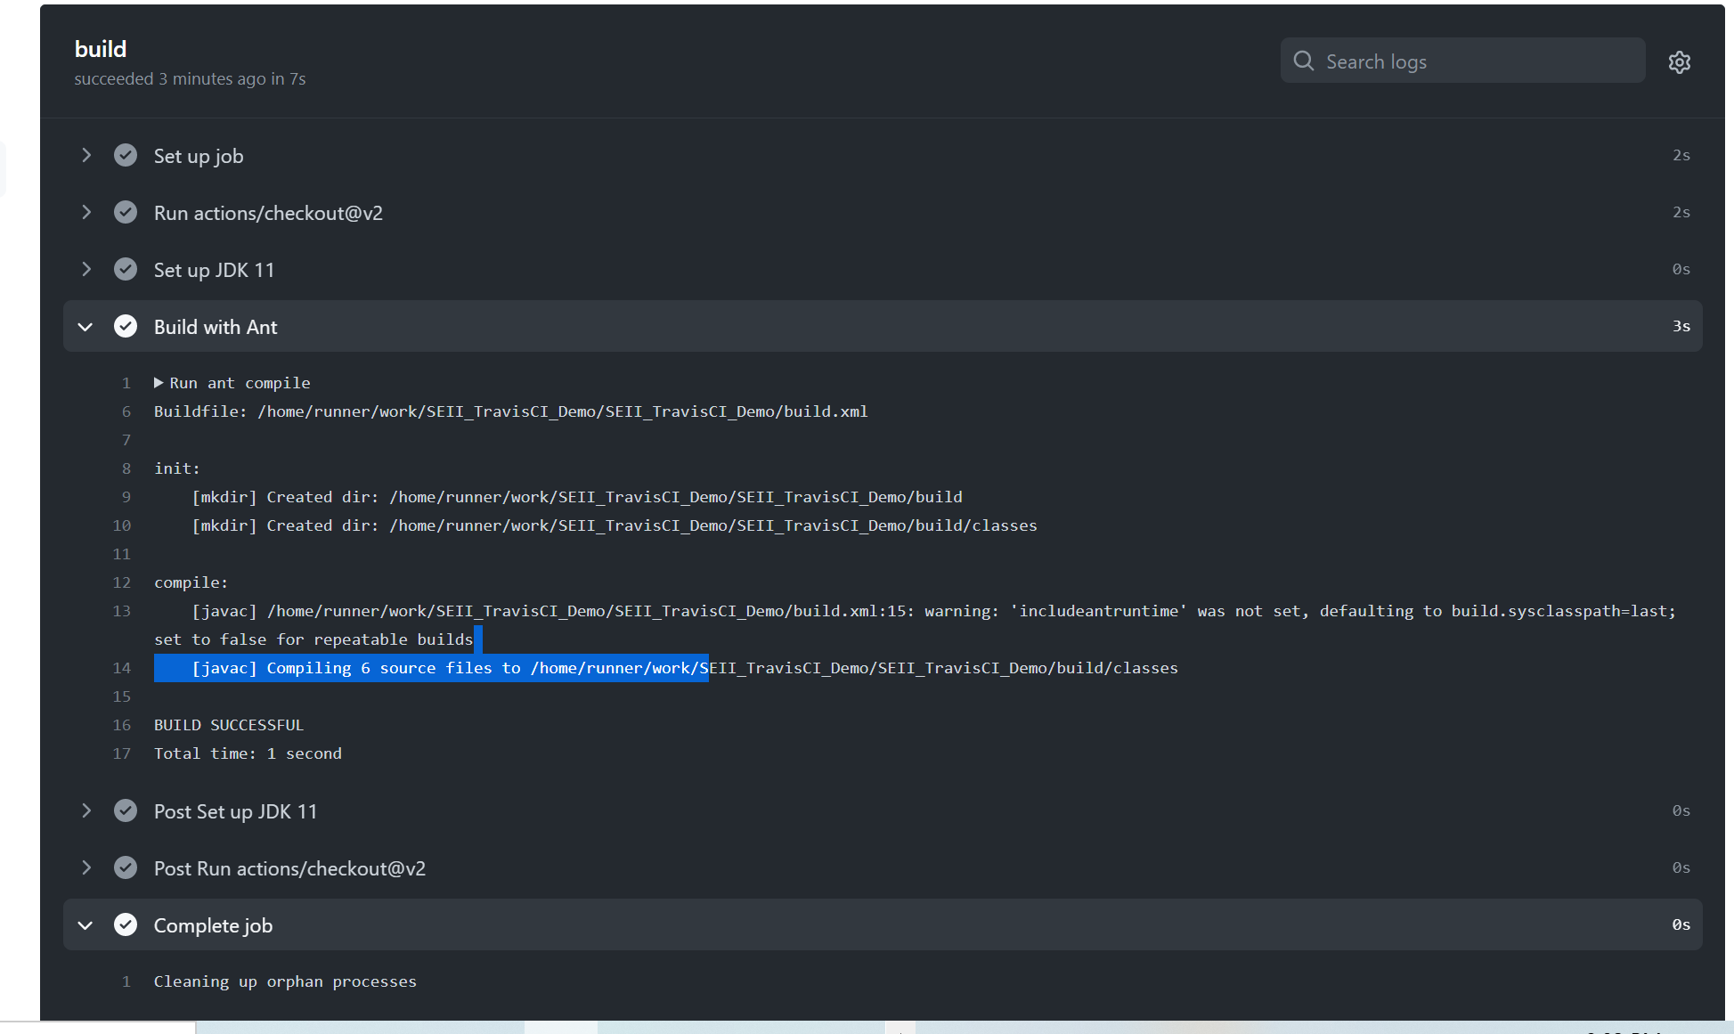

Slide 58
Reference
Chapter 3 and 6, Continuous Delivery, Jez Humble and David Farley
http://article.sapub.org/10.5923.j.ac.20201001.02.html
https://docs.github.com/en/actions/using-workflows/events-that-trigger-workflows

Slide 59
Set up TravisCI for a GitHub project
Set up TravisCI for (https://docs.travis-ci.com/user/tutorial/):
Fork this repository:
https://github.com/shaoweiwang2010/SE_course_TravisExercise
Go to https://travis-ci.org/ and log in with your github account
In your profile page, enable Travis’s access to the repo of TravisExercise
On your machine clone your repository
git clone REPLACE_THIS_BY_YOUR_REPO_URL
Add a .travis.yml file to your forked repository
specify the language by putting: language: java
Push a change to break the build (in your forked repo) and see if Travis finds it!
You need to show your CI works and have empty tests available in the Sprint 2!
Notes:
https://docs.travis-ci.com/user/tutorial/

